Slide 1
Automatic Timetable Generation System
WITH MANUAL ADJUSTMENTS CAPABILITY

Slide 2

The Timetabling Problem
The creation of timetables is an NP-hard problem
NP-hard problems are difficult to find optimal solutions
This research attempts to solve the timetabling problem using a “Genetic Algorithm”

Slide 3
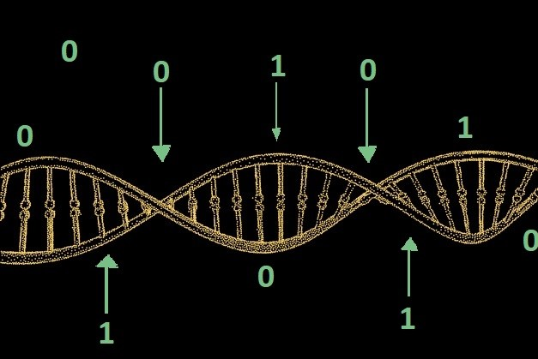
Genetic Algorithms
Genetic algorithms imitates biological evolution to find optimal solutions
They have characteristics of stochastic and heuristic algorithms
They are optimization algorithms

Slide 4
Processing Stage >>>
1. Genome
2. Chromosome
3. Mutation
4. Multipoint
Crossover
5. Fitness
Function
6. Population

Slide 5
Genome
In a genetic algorithm, a genome is potential solution to the problem being solved
In this work, it is represented by a very long string of binary bits
The entire solutions of the timetable (at an iteration) are encoded in the genome
Multiple genomes are being analyzed and processed simultaneously and are called a “Population”
A population size of 2 was used in this work

Slide 6
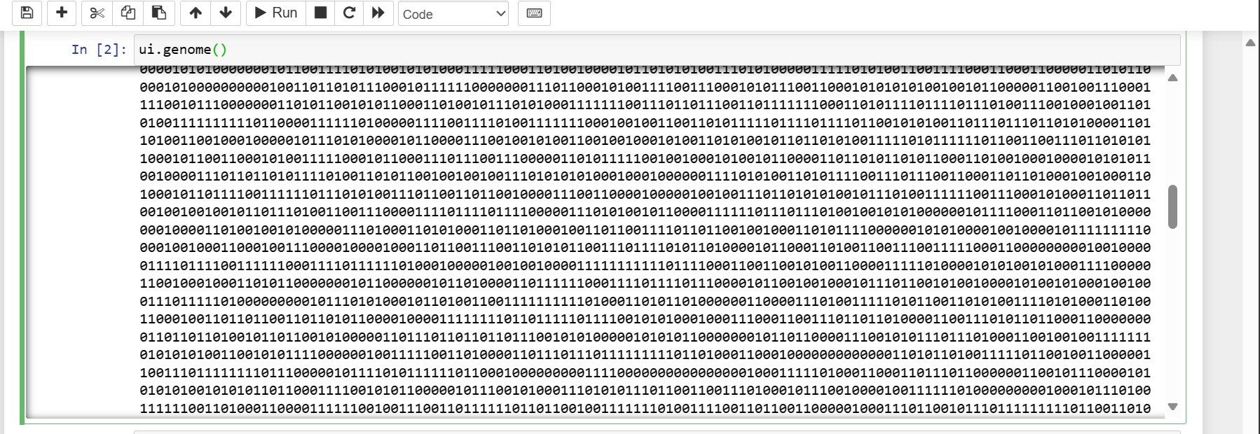
Genome Sample Used In The Research

Slide 7
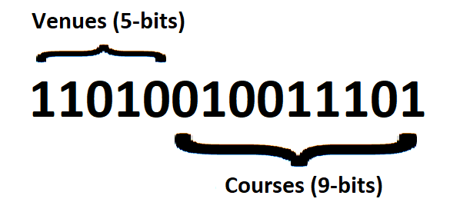
Chromosome
The chromosome refers to a genome segment that represents a particular trait of the solution
In the research, every 14 bits of the genome represented a class-venue pair
14 Bit Chromosome Sample

Slide 8
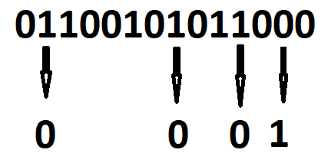
Mutation
Mutations introduce variations in the respective genomes.
In this research, randomly selected bits are flipped
The constant mutation rate is 5%
Mutation occurring on chromosome

Slide 9
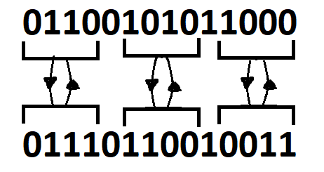
Multipoint Crossover
Crossovers are used to combine genes from two parent genomes to create offspring genomes.
This research implements multipoint crossovers
Representation of Multipoint Crossover

Slide 10
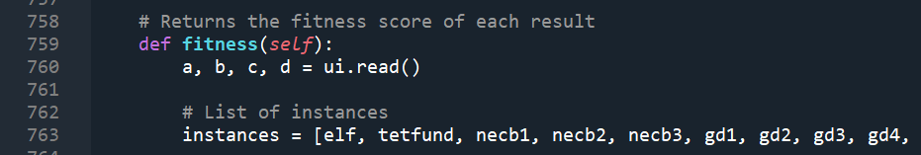
Fitness Function
It evaluates how well a genome solves the problem
In this research, the fitness method counts the violations that occur on each genome.
Code snippet showing the fitness method

Slide 11
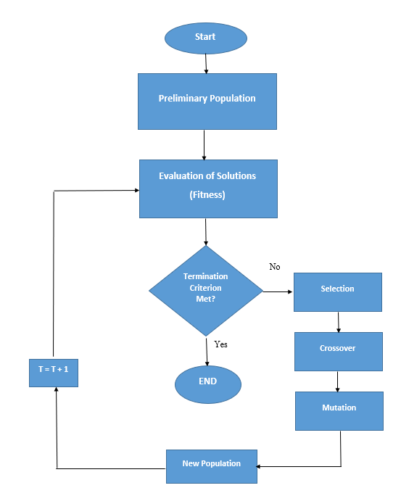
Genetic Algorithm Flowchart

Slide 12
Result Output
The timetable results (genomes) are generated as list
The list contents are converted to CSV file
These can be displayed and manually adjusted with spreadsheets such as MS Excel

Slide 13
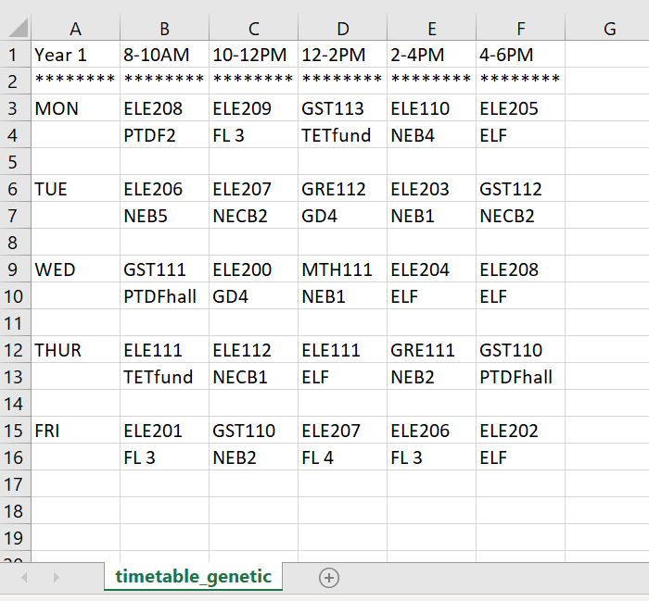
Timetable Output (Snippet)

Slide 14
Thank you!

